Slide 1

Refactoring
Stefano Coluccia

Slide 2

Argomenti trattati
Stefano Coluccia
19.07.2016
Refactoring example : Video Store
  Overview
Decomposing and redistributing the statement method
  Extract method
  Renaming
  Move method
State pattern
Questions

Slide 3
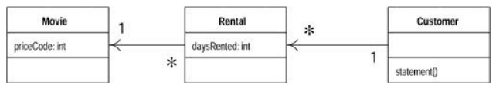
Starting point : video store example
Stefano Coluccia
19.07.2016
The best way to show you how refactoring works is with an example
It is a program to calculate and print a statement of a customer's charges at a video store
The program is told which movies a customer rented and for how long. It then calculates the charges, which depend on how long the movie is rented, and identifies the type movie
There are three kinds of movies: regular, children's, and new releases. In addition to calculating charges, the statement also computes frequent renter points, which vary depending on whether the film is a new release.

Slide 4
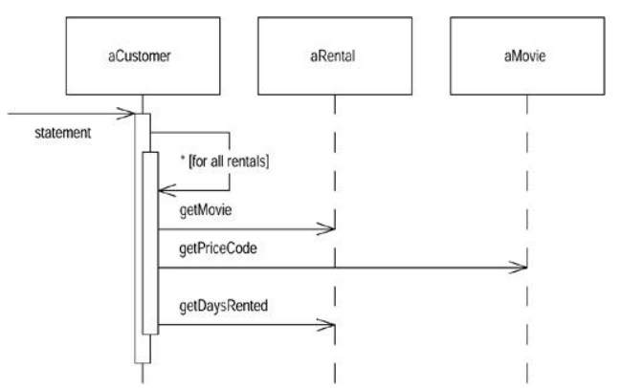
Starting point : video store example
Stefano Coluccia
19.07.2016
Interactions for the statement method

Slide 5
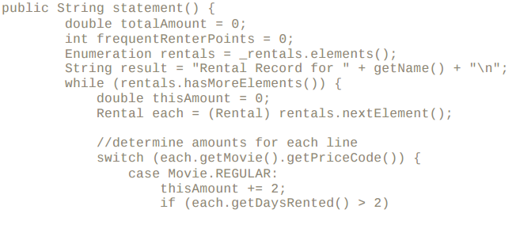
Starting point : video store example
Stefano Coluccia
19.07.2016
The statement method – part 1

Slide 6
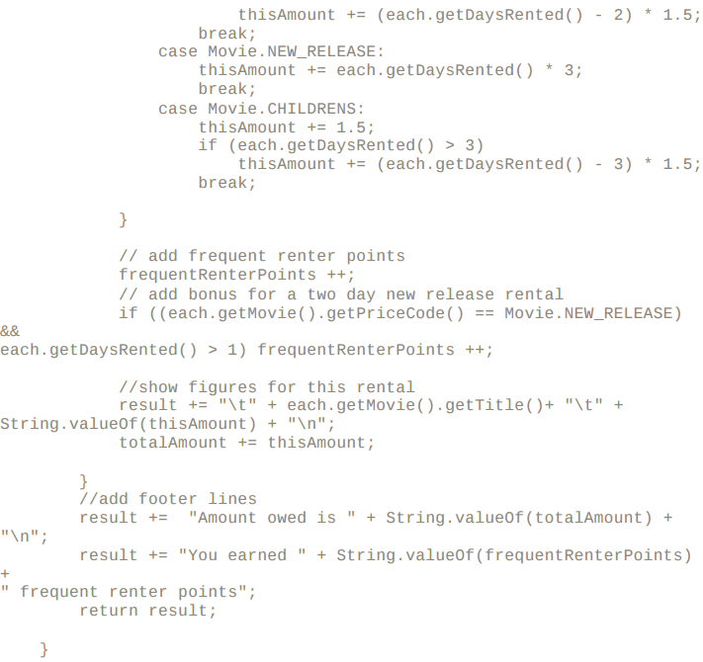
Starting point : video store example
Stefano Coluccia
19.07.2016
The statement method – part 2

Slide 7
Starting point : video store example
Stefano Coluccia
19.07.2016
The compiler doesn't care whether the code is ugly or clean. But when we change the system, there is a human involved, and humans do care.
Old engineering adage: "if it ain't broke, don't fix it." The program may not be broken, but it does hurt.
In this case we have a change that the users would like to make. First they want a statement printed in HTML.
The users want to make changes to the way they classify movies, but they haven't yet decided on the change they are going to make.
It's vital to have self-checking tests

Slide 8


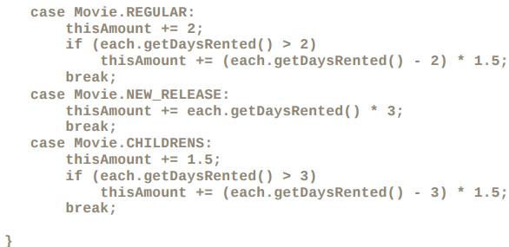

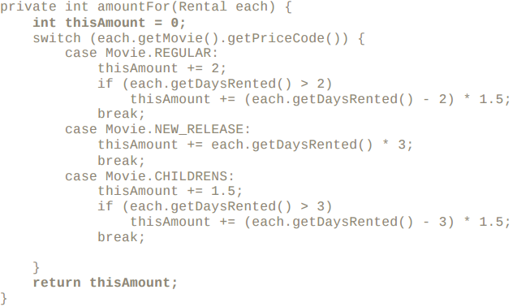
Decomposing and redistributing the statement method
Stefano Coluccia
19.07.2016
Extract method:
each ----> Any nonmodified variable I can pass in as a parameter.
thisAmount ----> Modified variables need more care. If there is only one, I can return it.

Slide 9
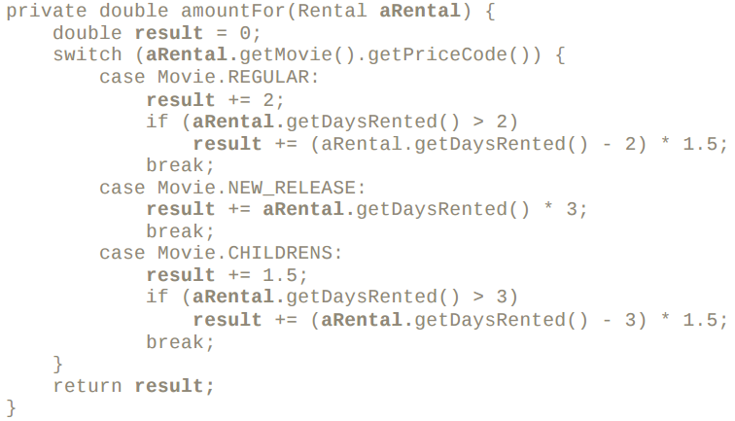
Decomposing and redistributing the statement method
Stefano Coluccia
19.07.2016
Renaming

Slide 10




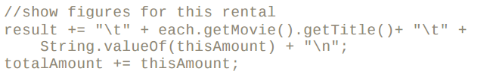
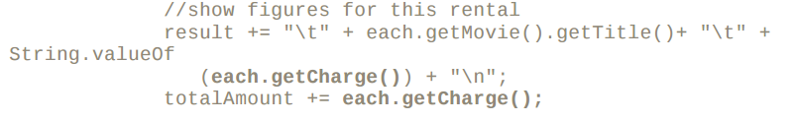
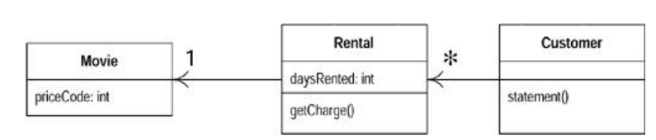
Decomposing and redistributing the statement method
Stefano Coluccia
19.07.2016
Move method
AmountFor method don't use customer info, but rental ----> move it and renaming it
Changing reference in Customer class

Slide 11
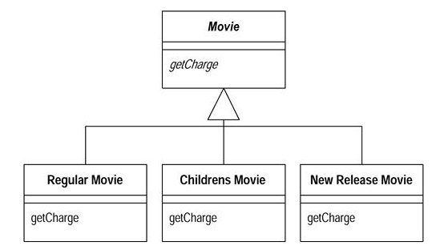
The state pattern
Stefano Coluccia
19.07.2016
Replace switch statement by using polymorphism
We have several types of movie that have different ways of answering the same question
We can have three subclasses of movie, each of which can have its own version of charge
A movie can change its classification during its lifetime. An object cannot change its class during its lifetime.

Slide 12
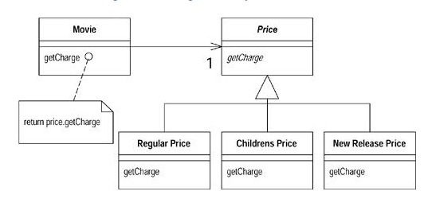
The state pattern
Stefano Coluccia
19.07.2016
The state pattern
Does the price class represent an algorithm for calculating the price, or does it represent a state of the movie?

Slide 13
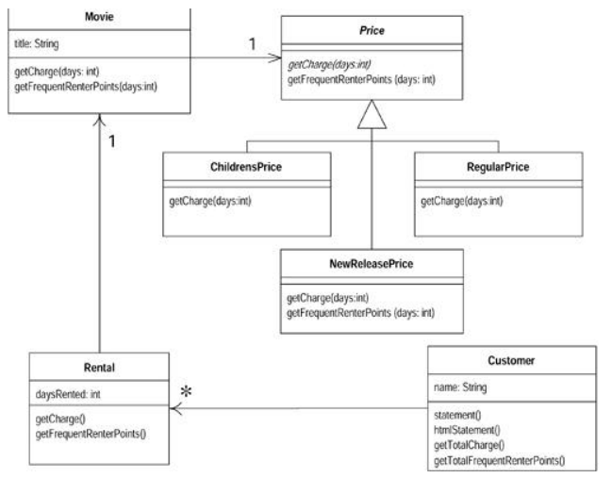
The state pattern
Stefano Coluccia
19.07.2016
The state pattern
The type code behavior is moved into the state pattern with Replace Type Code with State/Strategy.
The move method is used to move the switch statement into the price class.
Replace Conditional with Polymorphism to eliminate the switch statement.

Slide 14
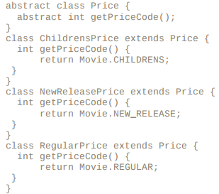
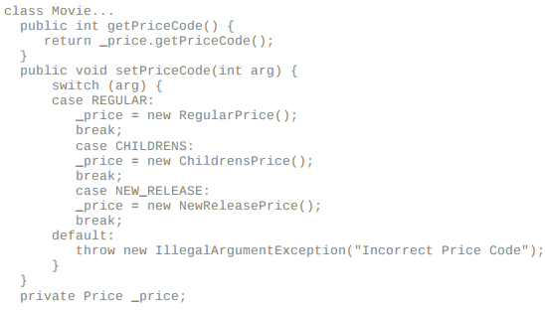
The state pattern
Stefano Coluccia
19.07.2016
The state pattern
Now add the new classes providing the type code behavior in the price object. An abstract method on price and concrete methods in the subclasses are used for this:

